Slide 1

Hidden Valley Lake
Community Services District
Local Hazard Mitigation Planning Project
Kickoff Meeting – September 10, 2019

Slide 2
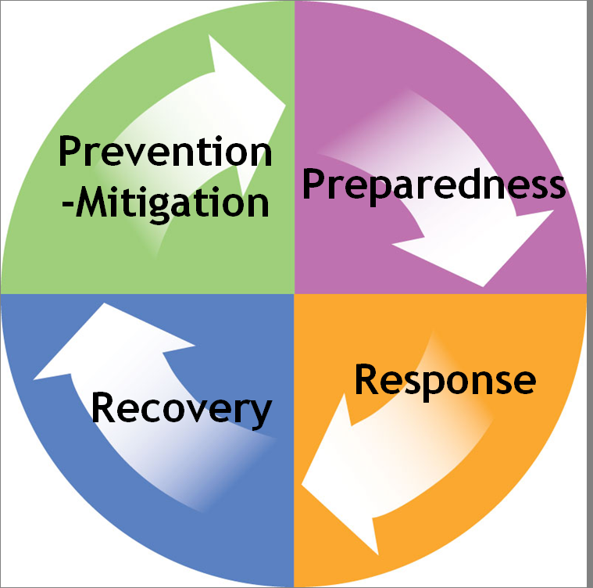
Four Phases of Emergency Management

Slide 3
Four Phases of Emergency Management
Preparedness
  Increases a community’s ability to respond when a disaster occurs
  NIMS: “a continuous cycle of planning, organizing, training, equipping, exercising, evaluating, and taking corrective action in an effort to ensure effective coordination during incident response.”
Response
  Response actions carried out immediately before, during, and after a hazard impact are aimed at saving lives, reducing economic losses, alleviating suffering, and limiting unfavorable outcomes
Recovery
  Actions taken to return a community’s systems and activities to normal
  Restoration of services/repair of physical, social and economic damages

Slide 4
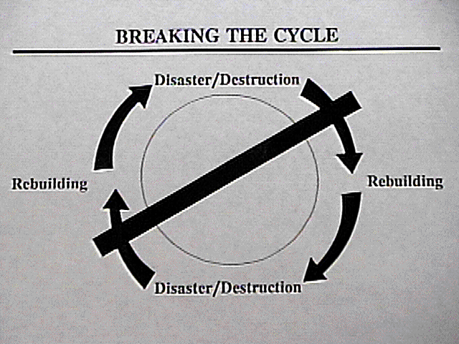
Hazard Mitigation
Mitigation defined: Any SUSTAINED action taken to reduce or eliminate long-term risk to human life and property from hazards
  Effective mitigation efforts can break the cycle of disaster damage, reconstruction, and repeated damage

Slide 5
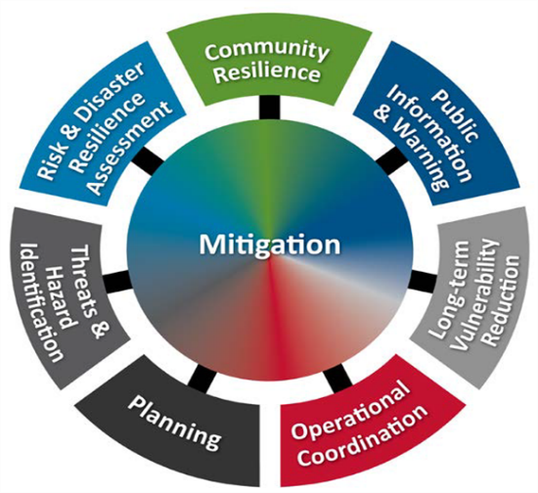
Hazard Mitigation
  Measures that reduce the chance of an emergency happening, or reduce the damaging effects of unavoidable emergencies
  Reduces loss of life, property damage, and economic hardship
  Increases communication and cooperation within the community through the planning process
  Allows communities to minimize post-
  disaster disruptions and recover more rapidly
  Long-term fix

Slide 6
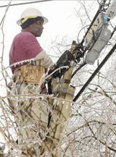
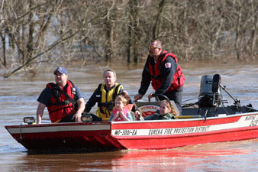
Why Hazard Mitigation?
More hazards
More people living in hazard-prone areas
More disaster declarations
Increasing costs of disaster response
and recovery is unmanageable

Slide 7
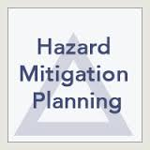
Hazard Mitigation Planning
Disaster Mitigation Act of 2000
  Continued eligibility for mitigation funds, pre- and post- disaster
  Guide mitigation activities in a coordinated & economic manner
  Incorporate into other existing planning mechanisms
  Future Development: plan and build wisely
  Reduce losses
  Make community more disaster resistant

Slide 8
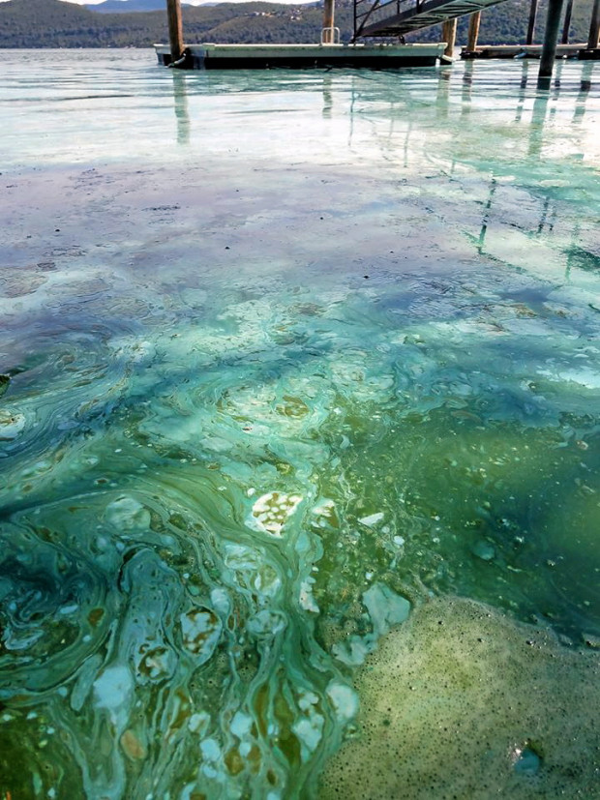
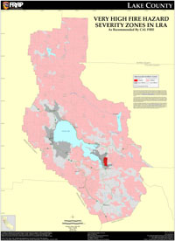
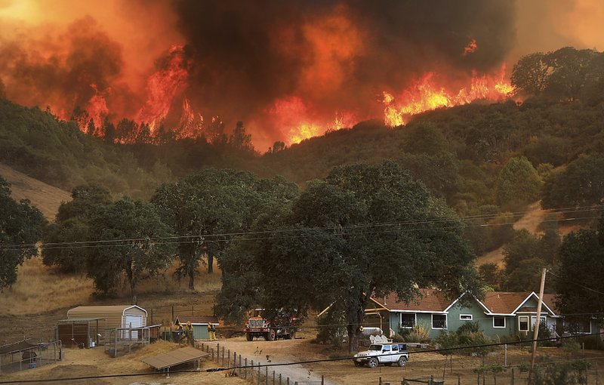
Hazard Mitigation Planning
Local Hazard Mitigation Plan
  a single or multi-jurisdictional planning document that identifies and profiles specific hazard risks & vulnerabilities and then addresses & prioritizes potential mitigation projects that can reduce those specific risks and vulnerabilities.

Slide 9
FEMA’s 4-Phase-10 Step DMA/CRS Planning Process
Phase I: Organize Resources
1) Get organized
2) Plan for public involvement
3) Coordinate with other departments and agencies
Phase II: Risk Assessment
4) Identify the hazard(s)
5) Assess the risks
Phase III: Mitigation Strategy
6) Set planning goals
7) Review mitigation alternatives
8) Draft and action plan
Phase IV: Adoption and Implementation
9) Adopt the plan
10) Implement the plan, evaluate its worth, and revise as needed

Slide 10

Phase I: Organize Resources
1) Get organized
2) Plan for public involvement
3) Coordinate with other department
and agencies

Slide 11
1) Get Organized – To Prepare the Plan
  Obtain communities’ commitment to mitigation
  Determine and assign staff
  Establish your mitigation planning team
    District Departments/Staff
    Other stakeholders: local, state, and federal agencies, public, neighboring jurisdictions
  District Staff
    General Manager
    Administration
    Water Resources Specialist
    Utility Supervisor
    Utility Operators
    Utility Workers/Technicians
    Water Resources Fellowship Interns
    Board of Directors

Slide 12



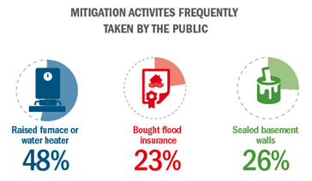
2) Plan for Public Involvement – Options
  Include on planning team
  Post data on websites
  Develop press releases
  Host public input meetings
  Hold “neighborhood” meetings
    On their “turf”
    Facilitates public involvement
    Review ideas, get feedback
  Use surveys/questionnaires

Slide 13
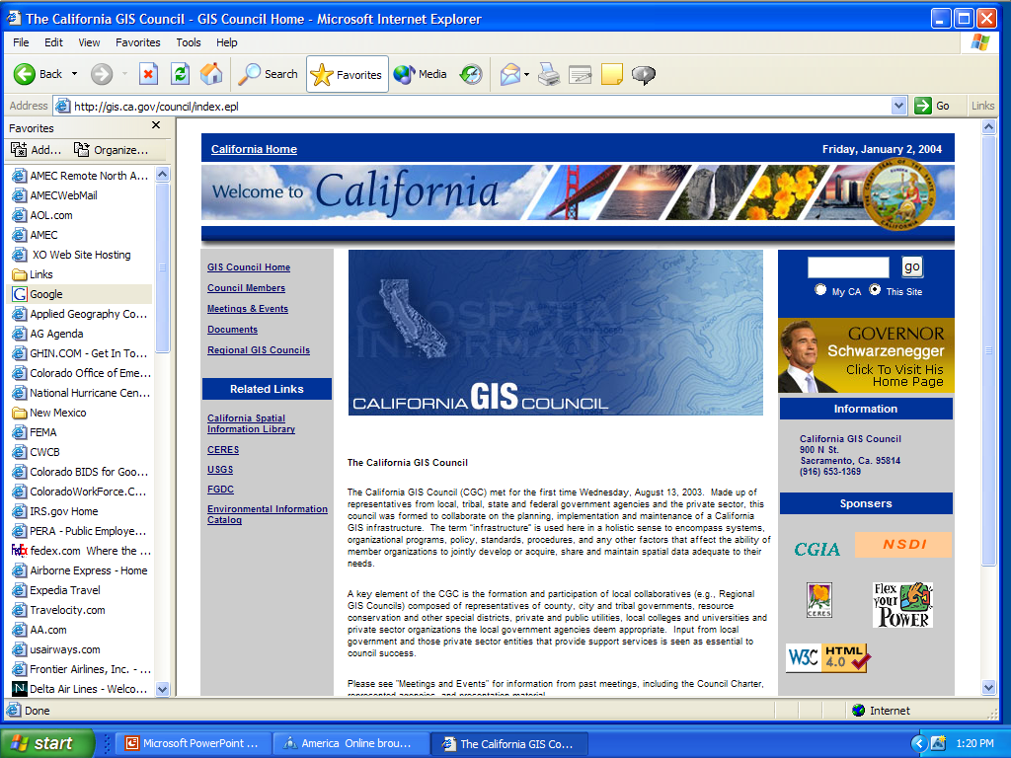
3) Coordinate with Other Departments & Agencies
  Cal OES State Hazard Mitigation Officer
  FEMA Region IX
  State Flood Insurance Coordinator
  US Army Corps of Engineers
  US Geological Survey
  Caltrans
  Cal Fire
  DWR
  National Weather Service
  Red Cross
  Neighboring Jurisdictions

Slide 14
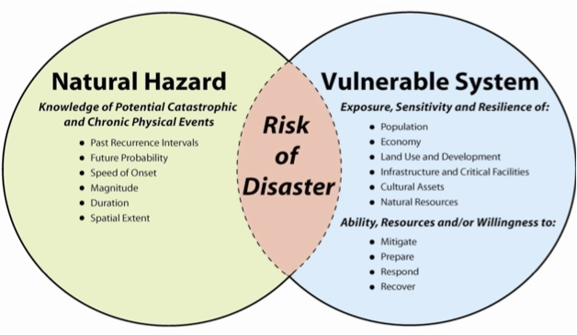
Phase II: Risk Assessment
Three Components
4) Hazard Identification (what can happen here?)
5) Vulnerability Assessment (what will be affected?)
Capability Assessment (how prepared are we?)

Slide 15
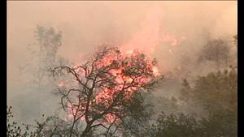
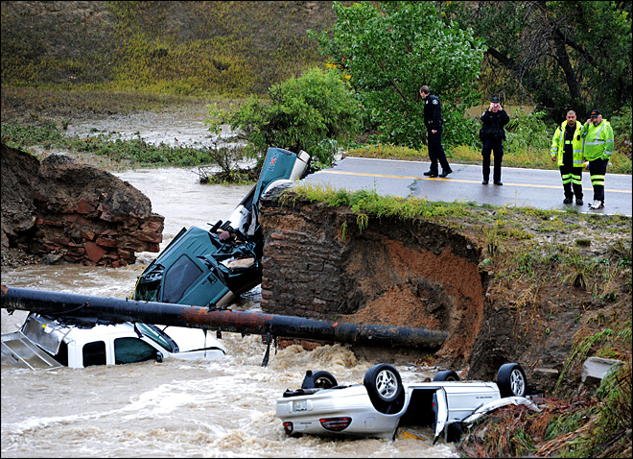

4) Hazard Identification & Profiles – What Can Happen Here?
  Hazard / Problem description
  Hazard extent (maps)
  Past occurrences
  Seasonal patterns
  Speed of onset / duration
  Magnitude / secondary effects
  Significance
  Frequency / likelihood of future occurrences

Slide 16
5) Vulnerability Assessment – What will be affected?
  Identify vulnerable infrastructure
  Identify development trends / constraints
  Identify historic, cultural, and natural resource areas
  Estimate losses
  Inventory residential and commercial structures
  Inventory critical facilities
  Determine value of structures
  Determine the number of people in the area

Slide 17
Capability Assessment
  Conduct an inventory of communities existing and proposed policies, programs, and ordinances that may affect its vulnerability to hazards.
  Evaluate the effectiveness of each for mitigation purposes. Note any gaps, shortfalls or conflicts associated with their design, enforcement of implementation. Identify any special opportunities.
  Determine the communities’ technical and fiscal abilities to implement mitigation initiatives. Include ability to attract and leverage funding.

Slide 18

Phase III: Develop a Mitigation Plan
6) Set planning goals
7) Review mitigation alternatives
8) Draft an action plan

Slide 19
6) Set Planning Goals – Using the risk assessment
  Areas of extreme vulnerability
    At-risk existing facilities
    At-risk critical facilities
    At-risk cultural and natural resources
    At-risk areas slated for future development
  Goals from other existing plans
  Other opportunities
    Repetitive losses
    Public education
    Increased insurance coverage

Slide 20
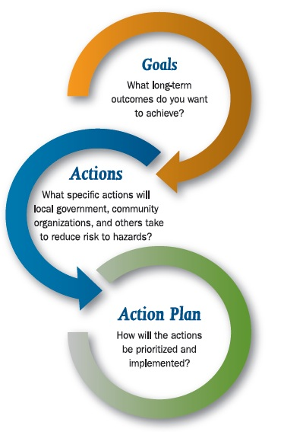
7) Review Mitigation Action Alternatives
  Prevention
  Property protection
  Natural resource protection
  Emergency services
  Structural projects
  Public information
  Multi-hazard measures and considerations
  No action

Slide 21
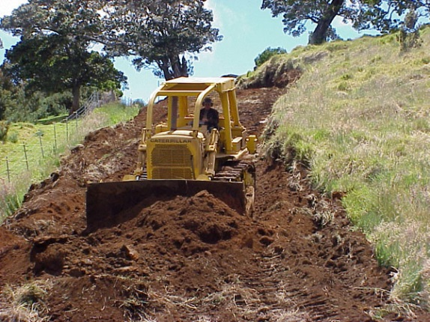
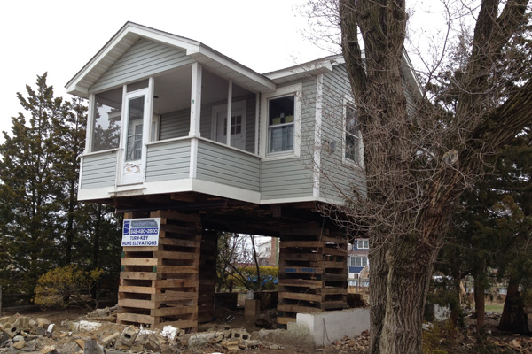
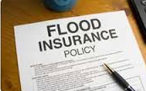
Hazard Mitigation Strategies
Three Ways to Promote Change
  Reduce the hazard – take an action to affect the hazard itself
  Reduce the impact (physical or economic) – take an action to mitigate structural loss or financial loss
  Change behavior/people

Slide 22
Hazard Mitigation: Flood
Reduce the hazard
  Divert or detain floodwaters (dams, levees, detention ponds, diversion structures
Reduce the impact (physical or economic)
  Floodproof / Elevate structures; Elevate utilities
Change behavior/people
  Designate high risk properties as open space
  Develop, adopt, and enforce floodplain regulations
  Train people to respond to flood watches and warnings
  Flood Insurance

Slide 23
Hazard Mitigation: Wildfire
Reduce the hazard
  Create fuel breaks
  Vegetation management
Reduce the impact (physical or economic)
  Build using fire resistant materials
  Create defensible space
Change behavior/people
  Use zoning restrictions to prevent building in highest risk or limited access areas
  Conduct evacuation planning activities
  Homeowner’s insurance

Slide 24
Hazard Mitigation: Earthquake
Reduce the hazard -?????
Reduce the impact (physical or economic)
  Conduct seismic retrofitting for critical facilities and infrastructure
  Strengthen and retrofit non-reinforced masonry buildings
  Retrofit building veneers to prevent failure
  Build a safe room to provide protection
  Install window film to prevent injuries from shattered glass
  Anchor rooftop-mounted equipment
Change behavior/people
  Increase public awareness about earthquake risk and safety measures
  Train builders, architects, engineers to enhance code use and enforcement
  Insurance

Slide 25
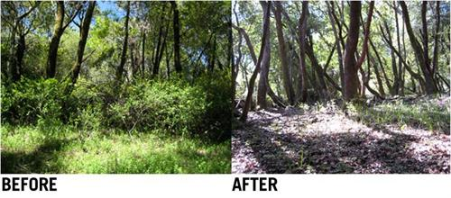
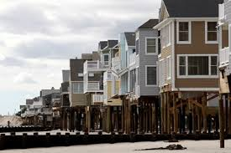
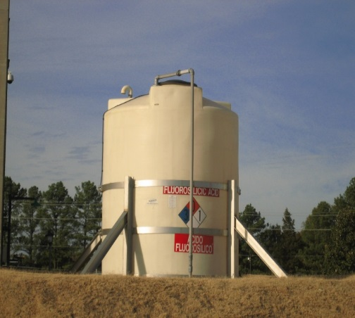
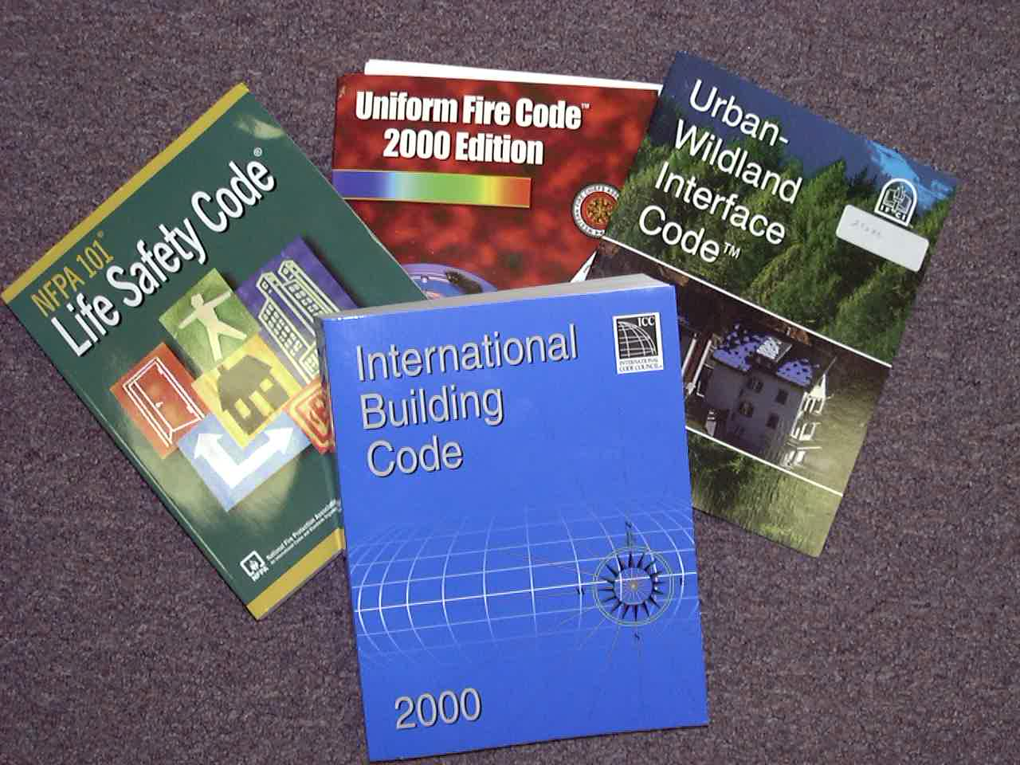

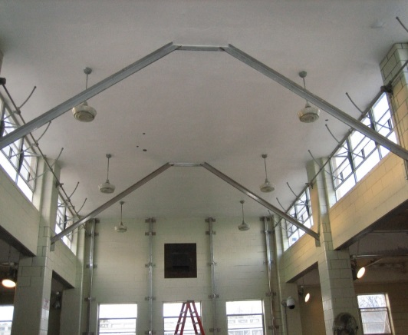
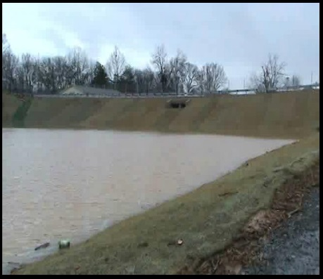
Hazard Mitigation Strategies

Slide 26
Review of Mitigation Alternatives –
Criteria for selecting mitigation measures
  Will it work?
  Is it cost-beneficial?
  Is it affordable?
  Is it legal?
  Is it fair?
  Do people want it?
  Is funding available?
  Are there administrative burdens?
  Is it politically acceptable to community leaders?
  Is it environmentally sound?

Slide 27
Phase IV: Adopt and Implement the Plan
9) Adopt the Plan
  Official Adoption by Council or Board
  Public input before adoption
10) Implement the Plan
  Assign an overall project manager
  Integrate actions into staff work plans
  Monitor changes in vulnerability
  Report on progress, publicize successes
  Revise the plan as necessary (every 5 years for DMA)

Slide 28
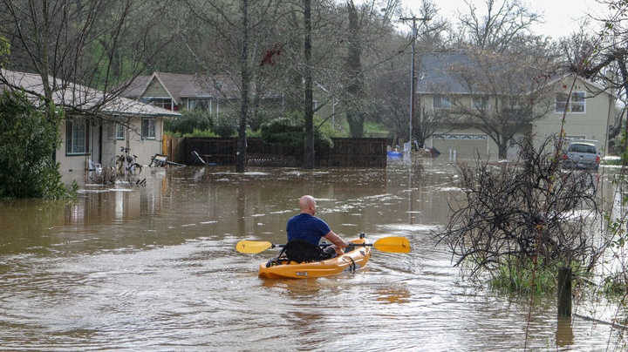
Hidden Valley Lake CSD LHMP 2019

Slide 29
The Role of the Hazard Mitigation Planning Committee/Steering Committee
Why you are here!
  Attend meetings and participate in the planning process
  Provide requested data
  Review drafts and provide comments
  Identify projects to be eligible for funding
  Coordinate and participate in the public input process
  Coordinate the formal adoption

Slide 30
The Hazards
Aquatic: quagga mussel
Climate Change
Dam Failure
Drought and Water Shortage
Earthquake
Flood: 100/500–year
Flood: Localized/Stormwater
Hazardous Materials Transportation
Landslide, Mud, and Debris Flows
Levee Failure
Seiche
Severe Weather: Extreme Cold and Freeze
Severe Weather: Extreme Heat
Severe Weather: Heavy Rains and Storms (winds, hail, lightning)
Severe Weather: High Winds
Volcanic and Geothermal Gases
Wildfire

Slide 31
Project Schedule
September 2018 – Project Kickoff Meetings (HMPC and Public)
November/December 2019 – Risk Assessment Meeting
January 2019 – Mitigation Strategy Meetings
February 2019 – HMPC Review Draft
March 2019 – Public Review Draft
April 2019 – Final HMPC and Public Meetings
April 2019 – Plan Submittal to Cal OES/FEMA
??? – FEMA APA Letter
??? – District Adoption
??? – Final FEMA Approval

Slide 32
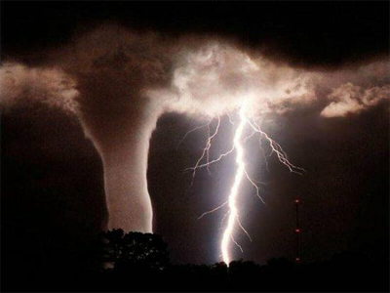
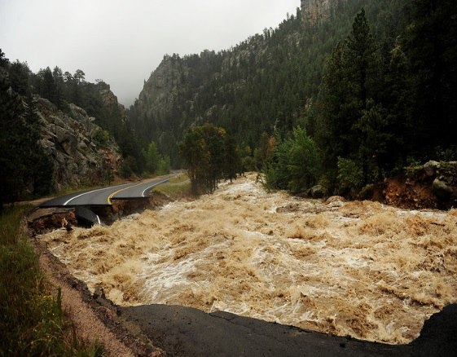
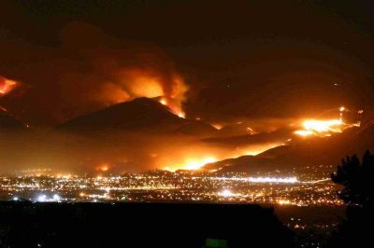
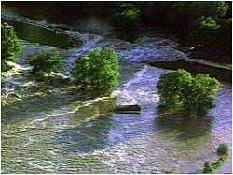
Hidden Valley Lake CSD, California
Thank you!
Local Hazard Mitigation Planning Project

